Slide 1
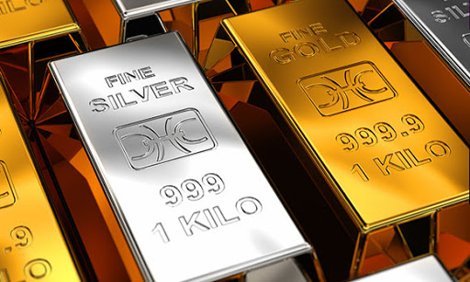
SUBREDDIT CLASSIFICATION
Classifying subreddit posts:
Gold and Silverbugs

Slide 2
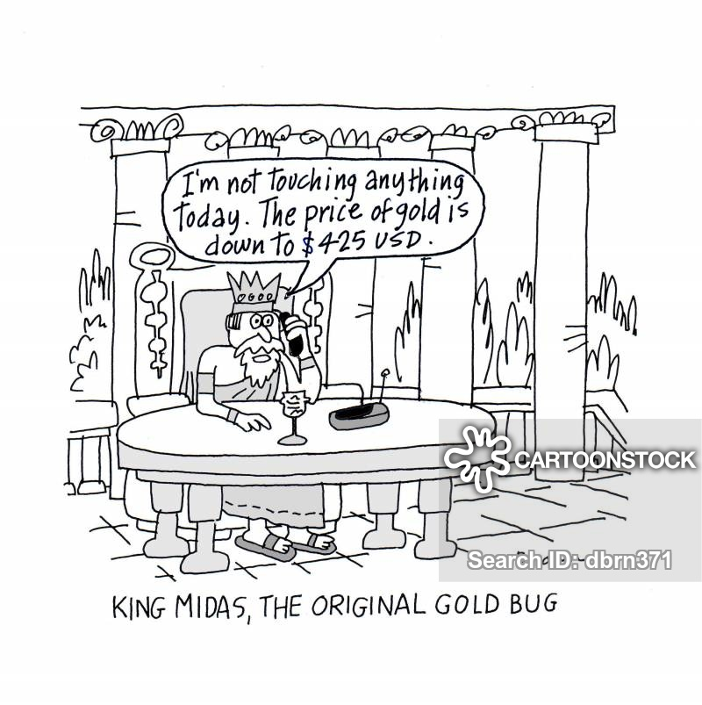
What is a gold bug or silver bug?
Gold bug is a term frequently employed in the financial sector and among economists in reference to persons who are extremely bullish on the commodity gold as an investment and who thinks its price will perpetually increase. Similarly, the term silver bug is explained in the same fashion except that focus is on silver.

Slide 3
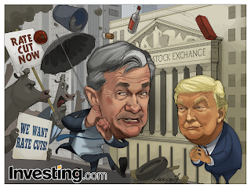
Background
Gold and silver have been recognized as valuable metals, and have been coveted for centuries. Precious metals can be a good portfolio diversifier and hedge against inflation and market risk.
Besides owning physical metal, investors can also gain access through the derivatives market, metal ETFs and mutual funds, and mining company stocks
COVID-19 pandemic have caused unprecedented volatility and fear in the financial markets. In mid March 2020, US Fed slashes rates to near zero, rolls out massive stimulus in an emergency response to the COVID-19 threat.
Market uncertainty and lower economic growth is expected to drive precious metal demand.

Slide 4
Problem statement
I am a financial quantitative analyst with a Hedge fund company. Recently, our company is re-balancing our portfolio on precious metals and I was tasked to leverage on data to identify any trends, sentiments in precious metals sector.
The first step is to use a classification models to differentiate between a gold and silver related Reddit post. This is critical before we proceed to the next step
Secondly, to examine Reddit's post and gaining insights to :
Which precious metal is best for investment purposes?
Which form of precious metals investment (CFDs, ETFs, futures, gold related stock, physical holdings)
Any other findings from post related stats like the number of comments of likes to a title post

Slide 5
Data analysis
Getting and cleaning data
The Subreddit posts are uniquely identified based on the variable 'name'. After removing duplicates, I have 875 counts of Subreddit Gold and 1041 counts of Subreddit Silverbugs
From the original scrapped data, it is narrowed to the following: 'post_id','author','title','post_body','comments','num_comments','ups', 'subreddit’
Models and Accuracy
The approach is to use a classification model and try to classify random posts into the correct Subreddit category.
The dependent variable for the classification model is Subreddit and the independent variables are: title and comments
The classifications models tried were Naive Bayes and Logistic Regression and Random Forest.
The best model was the Logistics Regression with TfidfVectorizer, having a test accuracy of 74.7%
Models | Train Score | Test Score
Naive Bayes | 0.863 | 0.706
Logistic Regression | 0.865 | 0.747
Random Forest | 0.967 | 0.745
Models train test score

Slide 6
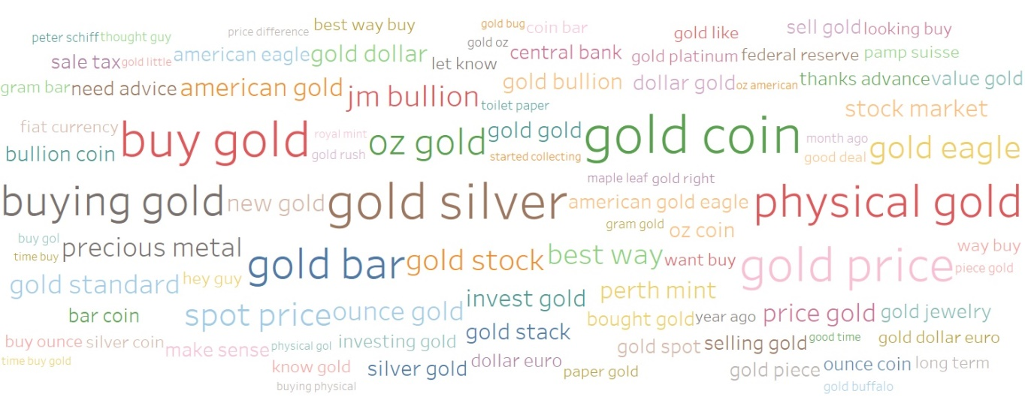
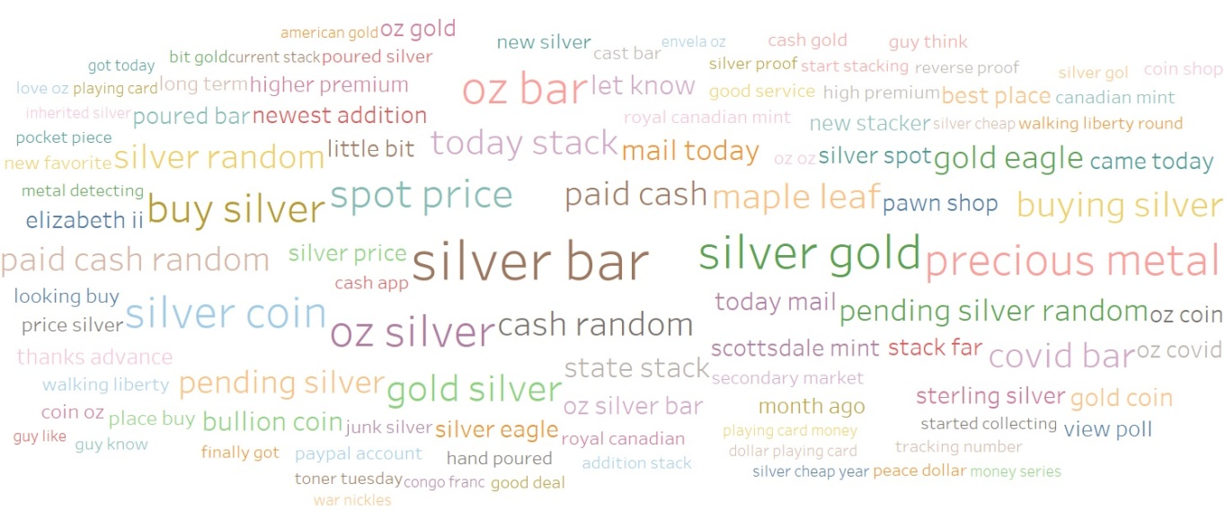
WORD clouds
A lot of discussion on buying gold. Indicating strong sentiment to purchase gold
On Silverbugs, there is a slightly tone down of discussion on buying silver as compared to gold
On the different forms of precious metals investments, physical holdings is most preferred
**The American Gold Eagle is an official gold bullion coin of the United States
Source: https://en.wikipedia.org/wiki/American_Gold_Eagle
Gold Word Cloud
Silverbugs Word Cloud

Slide 7
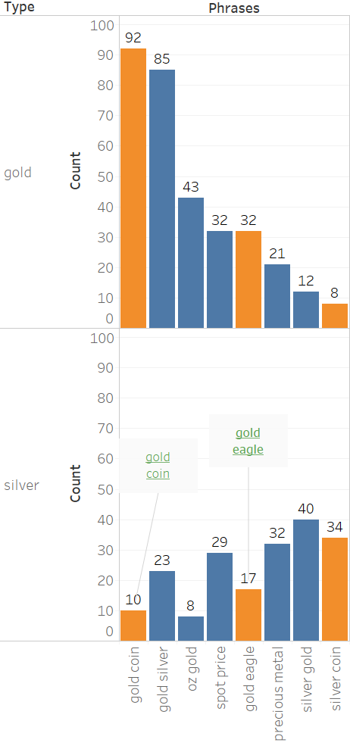
What is common?
Orange bars indicate interest in physical metals
(tagged by keywords: coin, gold eagle)
Strong gold sentiment Gold Subreddit show strong interest in gold coins and gold eagle at with a total count of 124. Silver Subreddit, showed a modest interest in silver coins at 34 counts
Silverbugs also shows interest in gold There are 3 orange bars on the gold side. Silverbugs has 2 out of its 3 orange bars showing interest in gold coin and gold eagle
Top common phrases in the 2 subreddit

Slide 8
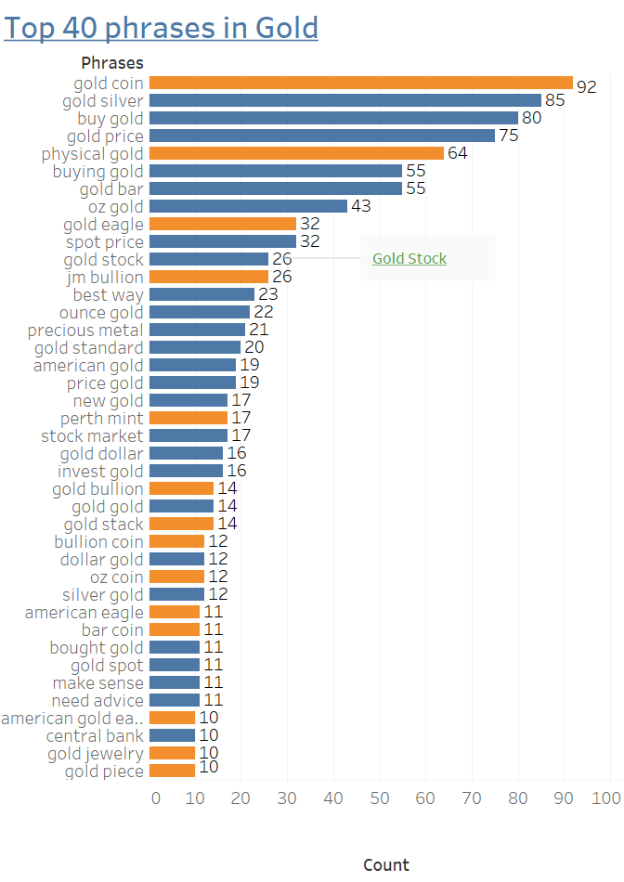
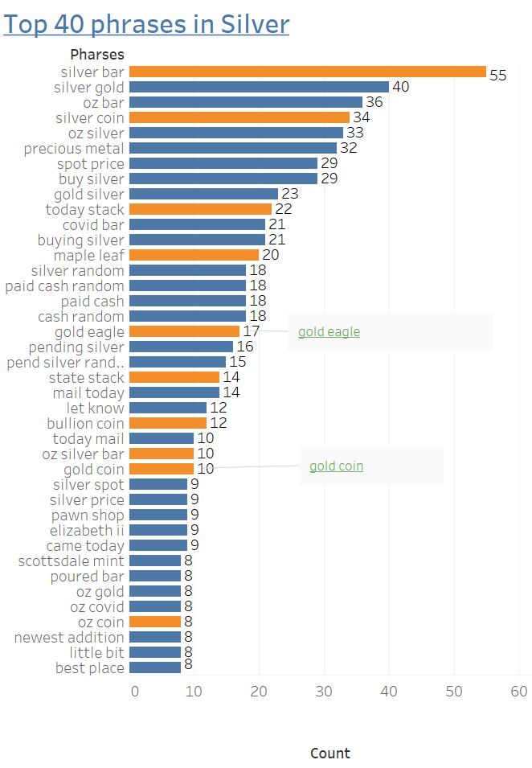
The top 40 phrases
Stronger sentiment on Gold On gold, 14 orange bars vs 7 on Silver
“Buy/ Buying” phrases count Gold phrases “buy/buying gold” - 135 counts(total)
Silverbug phrases –
“buy silver”29 counts
Preferred form of metals investment Physical forms of metals preferred. Only Gold stocks was mentioned in gold subreddit

Slide 9
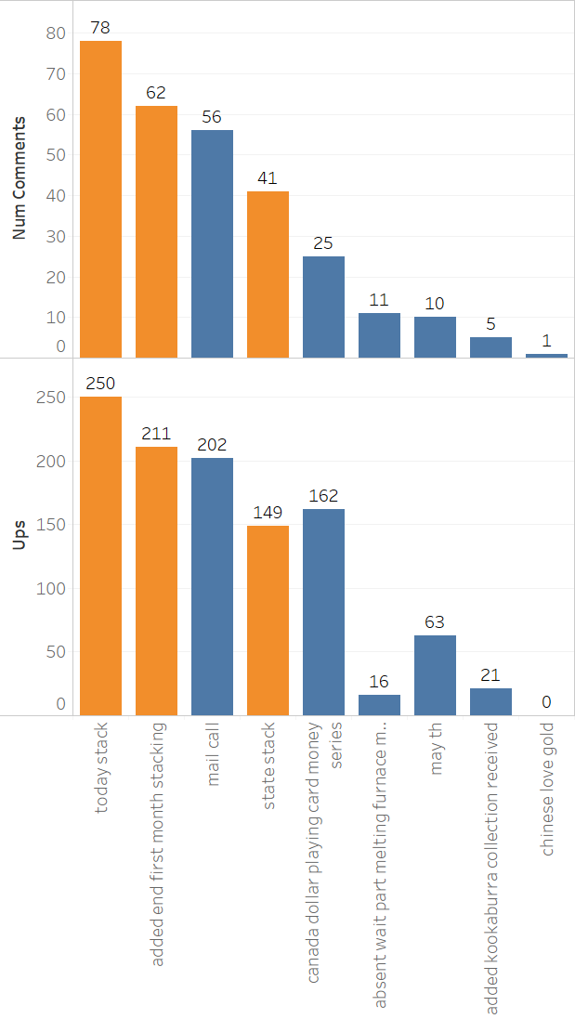
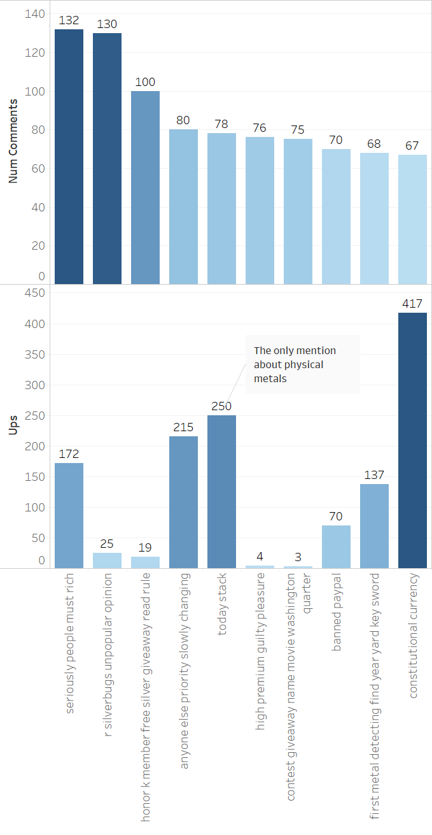
Popular post titles trends
Gold is ‘winning’ 3 orange bars on Gold and none on Silverbugs. In addition, these titles on physical gold have high engagement and popularity based on the comments and ups count.
Trend observed On Gold, the number of comments and up votes in the same upward trend. The trend is reverse on Silverbugs
Relevant phrases Silverbugs phrases are more sparse an random (convid bar, cash random etc)., seemingly, going off-topic. There us only 1 bar in Sliverbug that mentions ‘stack’
** 'Silver Stacking'. A term that has grown in popularity and is now used to describe a person who accumulates small pieces of silver like coins, bars, and other silver items. Same applies to 'Gold Stacking‘
Source: https://www.bleyerbullion.co.uk/what-is-silver-stacking

Slide 10
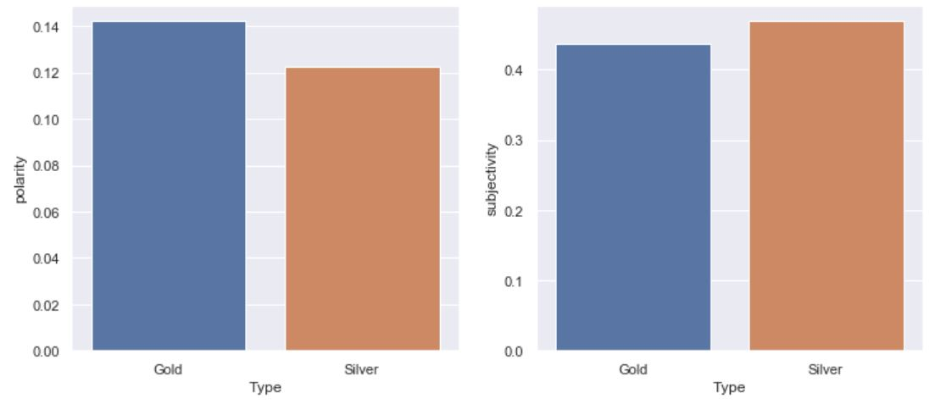
Sentiment Analysis
Sentiment analysis using TextBlob showed that subreddit Gold had a marginal higher positive sentiment than Silverbug.
This coincide with my phrases based analysis
Observation: We can see the output is categorized between two — Polarity and Subjectivity.
Polarity is a float value within the range [-1.0 to 1.0] where 0 indicates neutral, +1 indicates a very positive sentiment and -1 represents a very negative sentiment.
Subjectivity is a float value within the range [0.0 to 1.0] where 0.0 is very objective and 1.0 is very subjective. Subjective sentence expresses some personal feelings, views, beliefs, opinions, allegations, desires, beliefs, suspicions, and speculations where as Objective sentences are factual.

Slide 11
conclusion
Gold is preferred over Silver
Silverbugs also shows interest in gold. Conversely, Gold subreddit show very little in silver
"Buy/Buying Gold" phrases at 135 counts vs "Buy Silver" at 29 counts. That’s almost more than 4.5 times more!
Gold has 3 post titles related to physical holdings of gold('stacking'). Not just that, these posts are in the top 4 categories in terms of number of comments and up votes on these title On the other hand, SIlver has just one related post title
Sentiment analysis showed that Subreddit Gold had a marginal higher positive sentiment than Silverbug
Trend on the physical holdings of precious metals(Gold and Silver)
On both Gold and Silver, physical holdings is most preferred
In the Gold top40 phrases chart, there is only one mention on "Gold stock" vs 14 orange bars(terms that relate to physical holdings)
Limitations:
Insufficient data to generate There isn’t enough data just from Reddit alone. Beside, it would be better to get data from dedicated precious metals sites like kitco.com
A further step into sentiment analysis could include manual or hybrid based algorithms instead of automatic ones

